Slide 1
Library & Information Profession in Digital Lives
Makiko Miwa: The Open University of Japan

Slide 2
Outline
My Professional Life
Recent trends of Libraries
Research on LIS Education
Future?

Slide 3
My Professional Life
Editorial (Motivation to become an information professional) 1974-76
MLS at Pittsburgh (database management; information retrieval) 1977-78
Doctoral Program at Keio University (Library & Information Science) 1979-83
Database Manager 1981-1983
Information Consultant business 1983-2016
Ph.D. at Syracuse (Path to researcher life) 1994-2000
Researcher at the National Institute of Multimedia Education 2001-2008
Professor of the Graduate University of the Advanced Studies 2003-2016
Professor of the Open University of Japan 2009-present

Slide 4
Areas of Frequently Requested Information
health and medical information
business information
Science and Technology information
legal information

Slide 5
 | History of ICT in Libraries | My Experience
1950s | Cranfield Project | Birth
1960s | Bibliographic Databases (CA; MEDLERS) | High School
1970s | MARC; Online Bibliographic/Fulltext Databases (DIALOG; ORBIT; LexisNexis) | Undergrad; Time Life; MLS (Pittsberg); Database Manager (Tsukuba U)
1980s | OCLC; Computer-Readable Catalogues; OPAC (OCLC); Multimedia Databases | Keio Doctoral Student Information Broker
1990s | Commercial Internet Service; Web Services | Ph.D. (Syracuse).; AskERIC; Information Seeking Behaviour
2000s | Digital Libraries; Virtual refarence; RDF; Federated Search; e-Books; Dublin Core; FRBR; Institutional Repository; Online Bookstore (AMAZON); e-Learning | Mult-imediia Database Management (National Institute of Multimedia Education)
2010s | RDA; Open URL (Link Resolver); LOD; Google Books; MOOCs; Big Data; Altmetrics | Digital Literacy Education; Data Science Curriculum Development (The Open University of Japan)
2020s | ??? | Happy Retirement

Slide 6
Recent Trends of Libraries

Slide 7
Recent Trends of Academic libraries Learning and Research Support
Learning Commons
Online Database
Online Reference
Institutional Repository
Research Data Management
Institutional Research Administration
Digital Archives
Learning Analytics

Slide 8
Recent Trends of public libraries Problem-Solving Consultant
Support Life-long Learning of the Community
Comprehensive Reference Service for Clients’ Problem-Solving
Health & Medical Information for Patients and Family
Business Information for Local Business and Entrepreneurs
Legal Information for Local Clients
Science & Technology Information for Life-Long Learning
Information Literacy training
digital Literacy Training for Digital Divide
Information-Seeking Training for Local Clients

Slide 9
RecenT rends of t School libraries Support Self-Regulated Learning
Information Literacy education
Enhance Students’ Reading Skill
Offer Space and Tools for Inquiry-based Learning
Offer Space for Alienated Students
Support Taching

Slide 10
Recent Trends of Special libraries Knowledge Management Hub
Record Keeping
Business Intelligence
Manage and Analyse Internal Data
Handle and Curate Big Data
Hadoop and Big Data Analytics for Marketing
Archives

Slide 11
Research on Lis Education

Slide 12
Research on LIS Education
KALIPER: North America (1998-2000)
European Curriculum (2002-2004)
Liper: Japan (2003-2006)
GlobaLIS: Global (2010-2014)
Trends of MLS programs [2016]

Slide 13
KALIPER: North America (1999-2000)
Assess the nature and extent of curricular change by school surveys, case studies of 27 schools, an analysis of curricula and faculty opinions, an analysis of LIS job announcement, and an analysis of faculty specializations
LIS curricula are addressing broad-based information environments and information problems.
A distinct core has taken shape that is predominantly user centred.
Offering institutions in different formats to provide students with more flexibility.
Expanding curricula by offering related degrees at the undergraduate, mastera7s and doctoral levels.
Identified future possibilities
Demands of students, employers, graduates, and professional associations for graduate competencies.
Growth and expense of supporting emerging technology.
Availability and presence of faculty with new subject expertise.
Competition from other LIS programs.
Availability of financial support for innovation.
Pettigrew, K. E., & Durrance, J. C. (2001). KALIPER: Introduction and overview of results. Journal of education for library and information science, 170-180.
Notes:
The project, conducted between 1998 and 2000 by 20 schools, working in five teams, representing 13 programs in the United States, Canada, and England, assessed the nature and extent of major curricular change in LIS education across North America.
- In addition to libraries as institutions and library-specific operations, LIS curricula are addressing broad-based information environments and information problems.
- While LIS curricula continue to incorporate perspectives from other disciplines, a distinct core has taken shape that is predominantly user centred.
- LIS schools are offering institutions in different formats to provide students with more flexibility.
- LIS schools are expanding their curricula by offering related degrees at the undergraduate, master’s and doctoral levels.

Slide 14
KALIPER: North America (1999-2000)
KALIPER (the Kellogg ALISE Information Professions and Education Renewal) project (1998-2000) extensively examined LIS curriculum in North America and identified five trends.
Development of broader frameworks for examining information problems,
Increased interdisciplinarity,
Stronger information technology infrastructure,
More effective use of technology to support curricular innovations,
More effective delivery of distance learning, greater flexibility in program delivery, and
The emergence of more user-centered curriculum.
Pettigrew, K. E., & Durrance, J. C. (2001). KALIPER: Introduction and overview of results. Journal of education for library and information science, 170-180.
Notes:
KALOPER, the project, conducted between 1998 and 2000 by 20 schools, working in five teams, representing 13 programs in the United States, Canada, and England, assessed the nature and extent of major curricular change in LIS education across North America.
- In addition to libraries as institutions and library-specific operations, LIS curricula are addressing broad-based information environments and information problems.
- While LIS curricula continue to incorporate perspectives from other disciplines, a distinct core has taken shape that is predominantly user centred.
- LIS schools are offering institutions in different formats, such as online, to provide students with more flexibility.
- LIS schools are expanding their curricula by offering related degrees at the undergraduate, master’s and doctoral levels.

Slide 15
European Curriculum (2002-2004)
European Curriculum Reflections on Library and Information Science Education for LIS School evolution => Research oriented universities,
Three unique core areas of LIS:
Knowledge organization
Information use behaviour
Information retrieval
Spiral model of curriculum development (North America Model)
Specific professional skills => Theoretical knowledge applicable to practices
Lorring, L., & Kajberg, L. (2005). European curriculum reflections on library and information science education. Royal School of Library and Information Science.
Notes:
In Europe, there was a study conducted based on the collaboration of the Royal School of Library and Information Science and EUCLID, an organization of LIS education institutions.
The goal of the study was to identify the current situation of European LIS education program in order to develop a common curriculum reflecting with the Bologna Profess to reform them to be research-oriented universities.
The study identified three core areas unique to LIS. They are: knowledge organization, information use behavior, and information retrieval.
Following the North-American mode of Professional LIS Education on master’s level, with the definition of specific professional skills, which is, theoretical knowledge applicable to practices.

Slide 16
European Curriculum (2002-2004)
SCIENCE
Library User
Education
Informatics
HUMANITIES
Information retrieval
Information seeking
History of
Libraries
Knowledge management
User Study
Mediation of
Culture
Library
Management
Children’s Library
Knowledge
Management
Information Policy
SOCIAL SCIENCE
Lorring, L., & Kajberg, L. (2005). European curriculum reflections on library and information science education. Royal School of Library and Information Science.
Notes:
This is the graphical presentation of European Curriculum in 2002 and 2004.
Knowledge organization is defined as the core of the LIS, surrounded by information retrieval and information seeking.
External to the second core, there are major topics including user education, history, mediation of culture, children’s libraries, information policy, knowledge management, library management, user study, and informatics. General areas of science, social science, and humanities are located outside of the figure.

Slide 17
Equivalence of European LIS program and Bologna Profess
Qualification
Research / Education (Upper Level Librarian)
Director・ Preparation for Researcher
Information Professional
Goal
Able to use methodology effectively
Able to use tools effectively
Learn practical knowledge and techniques
Level 4 （Doctor）
Level 3
（Master）
Level 2
（Undergraduate LIS）
Level 1
（Undergraduate Minor）
Basis methodology in LIS
・Ontology
・Computer science
・Linguistics/Philosophy
・Social science
・Research methods
・Bibliometrics
Reference to Bologna Process
・Bachelor’s: at lease 3years（180-240ECTS*）
・Master’s: at least 2 years（60-120ECTS*）
・Doctoral: at least 3 years: （180ECTS*）
*ETCTS：way of converting different unit system to 60 units (1,500-1,800 hours) of Bologna Process
Notes:
This figure represents the new structure of the Euroean curriculum integrated into the flamework of Bologne model.
Level 1 represents undergraduate LIS minor offered as a part of other specialization.
Level 2 represents undergraduate LIS major, which is the minimum qualification for library and information professionals.
Level 3 represents master-level professional education of IIS. This is equivalent to the MLS ree offered in North America. Once you complete education of this level, you will be able to apply full professional job.
Level 4 represents doctoral education for researchers, teachers, and higher level librarians such as directrs.

Slide 18
LIPER: Japan (2003-2006)
Three-year research project to study LIS education for a Possible reform of Japanese LIS education system
The structure of Japanese LIS education has remained unchanged for 50 years, and the gap between it and overseas LIS education has been ever increasing.
The curricula and contents are not well standardized nor integrated into higher education programs and very few Graduates get employed in library markets.
New areas of education including IT skills and user behaviour are sought.
Many people seek to obtain LIS education for certification as librarians even though employment opportunities for full-time librarians are quite limited.
Proposals
(1) establish LIS examination for students so that they are able to self-evaluate what they have learned through LIS education and obtain better employment opportunities;
(2) introduce a new standard curriculum for information professional education to emphasize core areas of information organization, information resources and services, information systems and retrieval, management, IT, and a better understanding of user behaviour
Miwa, M., Ueda, S., Nemoto, A., Oda, M., Nagata, H., & Horikawa, T. (2006, August). Final results of the LIPER project in Japan. In Proceedings of the World Library and Information Congress: 72nd IFLA General Conference and Council:" Libraries: Dynamic Engines for the Knowledge and Information Society,"(http://www. ifla. org/IV/ifla72/papers/107-Miwa-en. pdf).
Notes:
The LIPER (Library and Information Professionals and Education Renewal), a three-year research project to study library and information science (LIS) education systems and curricula in Japan and overseas for a possible reform of the Japanese LIS education system, was completed in Mar
ch 2006.
Major Findings are:
-The structure of Japanese LIS education has remained unchanged for 50 years, and the gap between it and overseas LIS education has been ever increasing.
-The curricula and contents are not well standardized nor integrated into higher education programs and very few Graduates get employed in library markets.
-New areas of education including IT skills and user behaviour are sought.
-Many people seek to obtain LIS education for certification as librarians even though employment opportunities for full-time librarians are quite limited.
The LIPER project proposed:
(1) establish LIS examination for students so that they are able to self-evaluate what they have learned through LIS education and obtain better employment opportunities;
(2) introduce a new standard curriculum for information professional education to emphasize core areas of information organization, information resources and services, information systems and retrieval, management

Slide 19
Liper: Japan (2003-2006)
Professional
Academic Librarian
Professio
Professional
Public Librarian
Core Areas
Introduction to LIS
Information Users
Information Media
Information Services
Information systems
Management
Digital Resource
Professional
School Library and Media Specialist
Special Medical
Legal
Handicapped
Miwa, M., Ueda, S., Nemoto, A., Oda, M., Nagata, H., & Horikawa, T. (2006, August). Final results of the LIPER project in Japan. In Proceedings of the World Library and Information Congress: 72nd IFLA General Conference and Council:" Libraries: Dynamic Engines for the Knowledge and Information Society,"(http://www. ifla. org/IV/ifla72/papers/107-Miwa-en. pdf).
Notes:
The LIPER (Library and Information Professionals and Education Renewal), a three-year research project to study library and information science (LIS)
educati on systems and curricula in Japan and overseas for a possible re form of the Japanese LIS education system, was completed in Mar
ch 2006.
Major Findings are:
the structure of Japanese LIS education has remained unchanged for 50 years, and the gap between it and overseas LIS education has been ever increasing.
the curricula and contents are not well standardized nor integrated into higher education programs and very few Graduates get employed in library markets.
new areas of education including IT skills and user behaviour are sought.
many people seek to obtain LIS education for certification as librarians even though employment opportunities for full-time librarians are quite limited.
The LIPER project proposed:
(1) establish LIS examination for students so that they are able to self-evaluate what they have learned through LIS education and obtain better employment opportunities;
(2) introduce a new standard curriculum for information professional education to emphasize core areas of information organization, information resources and services, information systems and retrieval, management

Slide 20
GlobaLIS: Global (2010-2014)
Developed a database of core courses on master’s-level LIS programs.
Gathered descriptions of 286 courses in 34 programs offered by colleges and/or universities in 18 countries.
Data collection was mainly carried out by 3 GlobaLIS project members.
Data were analyzed into “Standard Curriculum for Education of Information Professionals” proposed by the LIPER project.
Course characteristics could be assigned to eight categories.
Specific characteristics of course distribution were identified according to the geographic regions of Asia, Oceania, North America, and Europe.
Findings reflect the distinct cultural and educational contexts of each region.
Results may prove useful as a basis for globalizing the curriculum for LIS programs in Japan.
Miwa, M., Kasai, Y., & Miyahara, S. (2011). GlobaLIS: Efforts in Japanese LIS education for global collaboration. Education for Information, 28(2-4), 125-136.
Notes:
GlobaLIS is a research project initiated by myself. We developed a database of core courses on master’s-level LIS programs.
Gathered descriptions of 286 courses in 34 programs offered by colleges and/or universities in 18 countries.
Even though we invited participation from educators from overseas, data collection was mainly carried out by 3 GlobaLIS project members.
Data were analyzed into “Standard Curriculum for Education of Information Professionals” proposed by the LIPER project.
Course characteristics could be assigned to eight categories.
Specific characteristics of course distribution were identified according to the geographic regions of Asia, Oceania, North America, and Europe.
Findings reflect the distinct cultural and educational contexts of each region.
Results may prove useful as a basis for globalizing the curriculum for LIS programs in Japan.

Slide 21
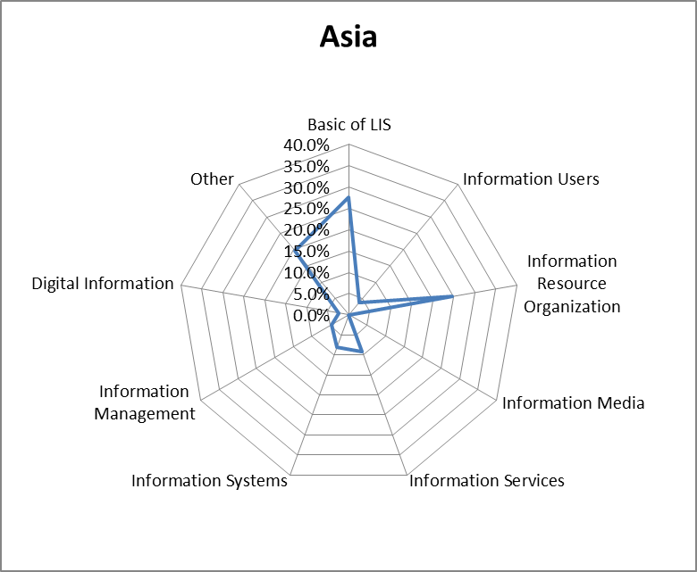
Results: Asia
Large share for Basic of LIS (introductory courses)
Larger share for Information Resource Organization (emphasize printed books and journals)
Larger share for Other (require students to write a master’s thesis)
Miwa, M., Kasai, Y., & Miyahara, S. (2011). GlobaLIS: Efforts in Japanese LIS education for global collaboration. Education for Information, 28(2-4), 125-136.
Notes:
In Asia, the two core courses of Basics of LIS and Information Resource Organization scored 27.6% and 24.6%, respectively. LIS programs in this region generally have an introduction to library (and information) science as the first required course for all students. The slightly larger share for Information Resource Organization is probably a reflection that many Asian LIS programs still emphasize printed books and journals in general studies, rather than digital content and/or materials in a particular genre. Other has the third largest share (19.7%) indicates that several graduate-level LIS professional programs in Asian countries require students to write a master’s thesis.

Slide 22
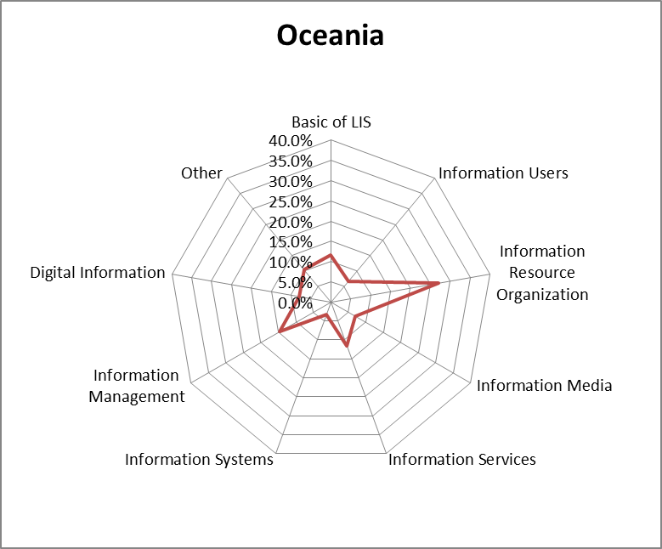
Results: Oceania
Largest share for Information Resource Organization (emphasize technical service tradition in printed & digital materials)
Larger share for Information Management
Large share for Information Services
Miwa, M., Kasai, Y., & Miyahara, S. (2011). GlobaLIS: Efforts in Japanese LIS education for global collaboration. Education for Information, 28(2-4), 125-136.
Notes:
In Oceania, the core course of Information Resource Organization accounts for the largest share (27.0%), which reflects the tradition of technical services in dealing with both printed and digital (networked) information. Information Management (14.5%) and Information Services (11.6%) receive greater attention in Oceania than in the other three regions. On the other hand, the relatively low figure of 11.6% for Basics of LIS is something of an anomaly compared with the other regions.

Slide 23
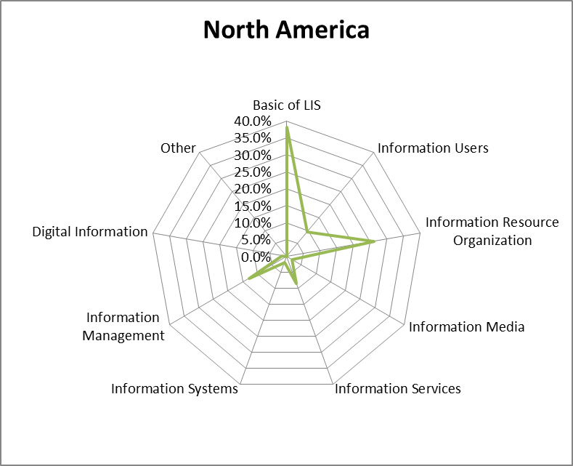
Results: North America
Largest share for Basics of LIS (research method course)
No courses for Other (standardized; no thesis required)
Miwa, M., Kasai, Y., & Miyahara, S. (2011). GlobaLIS: Efforts in Japanese LIS education for global collaboration. Education for Information, 28(2-4), 125-136.
Notes:
Basics of LIS represents a share of 38.0% in North America, the largest individual value in all the data, which reflects the fact that most LIS programs in this region have at least one research methods course and one internship or practicum course. On the other hand, no course in this region is classified as Other, probably because most North American LIS programs are standardized and do not require a thesis or dissertation to obtain professional status.

Slide 24
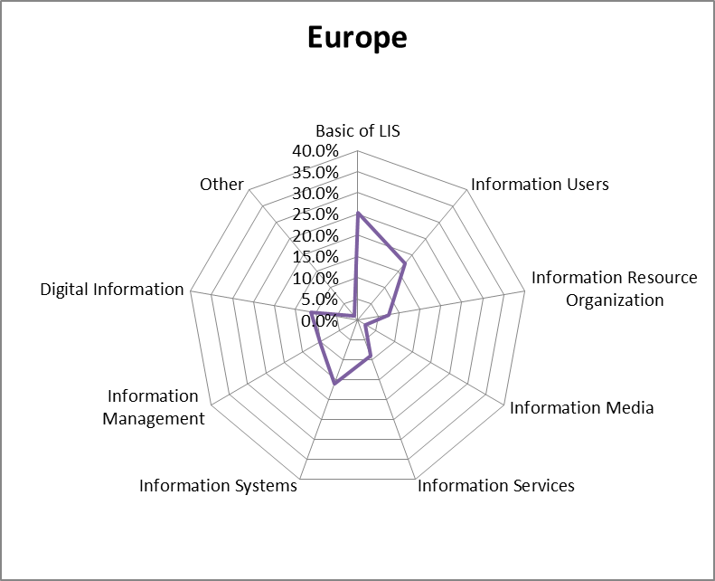
Results: Europe
Large share for Information Users (emphasizing social aspects of information)
Large share for Information Systems (emphasizing social aspects of information and information user behaviour)
Miwa, M., Kasai, Y., & Miyahara, S. (2011). GlobaLIS: Efforts in Japanese LIS education for global collaboration. Education for Information, 28(2-4), 125-136.
Notes:
Compared with the other regions, the core courses of Information Users (17.5%) and Information Systems (16.0%) stand out in Europe. The former may reflect the European tradition of emphasizing social aspects of information and information user behavior in LIS programs. The share of 11.1% for Digital Information indicates a growing emphasis on the digitization of cultural heritage materials (Kajberg, 2007).

Slide 25
Trends of MLS programs [2016] (Library Profession in US, UK, & AU)
Recent Changes in Curriculum
US
School of Information Sciences, University of Illinois--Urbana-Champaign
Library and Information Studies, Graduate School of Library and Information Science, University of North Carolina--Chapel Hill - School of Information and Library Science
UK
Information School, University of Sheffield
AU
School of Information Studies, Charles Sturt University
Notes:
Last year, I was asked to conduct a research on trends of academic librarians’ education overseas by our government. Because the time was limited, we chose only three countries to study. They are US, UK and Australia. We collected data on education system to train LIS Professional, skills and competencies of academic librarians, on the job training, and future perspectives of this occupation. Now I just introduce the recent curricula changes in four programs in three countries.

Slide 26
School of Information Sciences, University of Illinois--Urbana-Champaign
Degree Programs
Doctor of Philosophy (PhD)
Master of Science in Library and Information Science
MS in Information Management
Master of Science in Bioinformatics
Certificate of Advanced Study (CAS)
Certificate of Advanced Study in Digital Libraries
K-12 Library Information Specialist Licensure
Notes:
In US, we picked-up top two programs based on the ranking of US News World report. They are, School of information science, University of Illinois-Urbana-Champaign, and School of Information and Library Science, University of North Carolina at Chapel Hill.
This is the list of degree programs from which we chose Master of Science in Library and Information Science to examine.

Slide 27
School of Information Sciences, University of Illinois--Urbana-Champaign: Master of Science in Library and Information Science
Professional Pathways
Knowledge Management and Competitive Intelligence Corporate Librarian
Archives and Special Collections Archivists and Special Collection
Research and Information Services Information Literacy Educator
Information Organization and Management Cataloguer, Info. Architects, metadata Analyst
Data and Asset Management Data Manager & Curator, digital Repository Manager
Youth and K-12 Children and Young Adults Services in School & Public Lib
https://ischool.illinois.edu/academics/degrees/mslis/advising/plan-program/tracks
Notes:
There are six professional pathways.
Knowledge management and competitive intelligence is for those who seek cooperate librarian job.
Archives and special collections is for those who seek career in archivists and special collection.
Research and information services is for those who want to become information literacy educators.
Information organization and management is for cataloguers, information archtects, and metadata analysts. They seem to represent traditional librarians task.
Data and asset management is for those who seek career in data manager, curator, and digital repository manager.n
Youth and k-12 is for those who seek job in children and young adults service in school and public libraries.

Slide 28
School of Information and Library Science, University of North Carolina at Chapel Hill
Degree Programs
Bachelor of Science in Information Science (BSIS)
Master of Science in Library Science (MSLS)
Master of Science in Information Science (MSIS)
PSM in Biomedical and Health Informatics
PSM in Digital Curation
Post-Master's Certificate in Data Curation
Ph.D. in Information and Library Science
http://sils.unc.edu/
Notes:
Lets’ move to University of North Carolina, Chapel Hill.
They offer seven degree programs.
Among them we chose Master of Science in Library Science for examination.
By the way, PSM: Professioal Science Master Degree
Professional Science Master’s degrees combine a science or mathematics curriculum with a professional component designed to provide graduates with the necessary skills for a career in business, government, or nonprofit agencies

Slide 29
School of Information and Library Science, University of North Carolina at Chapel Hill Master of Science in Library Science (MSLS)
Pre-requisite: Information Technology Competency Requirement
Areas of Specialization
Academic Libraries
Adult Services in Public Libraries
Archives and Records Management
Children and Youth Services
Digital Libraries
Organization of Information and Materials
Reference
School Library Media
Special Libraries and Knowledge Management
https://sils.unc.edu/programs/graduate/msls
Notes:
This program require all new students to have a level of information technology competency. The freshman has to take the online test.
There are 9 areas of specialization.
Academic Libraries for college and university librarians.
Adult Services in Public Libraries
Archives and Records Management
Children and Youth Services
Digital Libraries
Organization of Information and Materials
Reference
School Library Media
Special Libraries and Knowledge Management

Slide 30
Academic Libraries
Notes:
This is the curriculum structure for academic library specialization. They consists of required courses, and four focuses including user services, collection, management, and cataloging. It also offer recommended courses.

Slide 31
Adult Services in Public Libraries
Notes:
This is the curriculum structure for those who seek career in public libraries. This is rather simple with required, highly recommended, and recommended courses.

Slide 32
Archives and Records Management
Notes:
This as a very popular curriculum for archives and record management. In addition to required courses, it provide reference, record management, preservation, and archival appraisal, in addition to suggested electives.

Slide 33
Children and Youth Services
Notes:
This is the curriculum for children and youth services.

Slide 34
Digital Libraries
Notes:
This is the curriculum for digital libraries. When they develop this curricula, I personally participated in and use this as the bases for a course I’m teaching at Chiba University in Japan.

Slide 35
Organization of Information and Materials
Notes:
This is the curriculum for organization of information and materials.

Slide 36
Reference
Notes:
This is the curriculum or reference.

Slide 37
School Library Media
Notes:
This is the curriculum for school library media specialist.

Slide 38
Special Libraries and Knowledge Management
Notes:
Finally, this is the curriculum for special libraries and knowledge management. This is quite similar to one in Illinois.

Slide 39
Information School, University of Sheffield Model of Blended Information Professionals
IT & Media
Conduit Specialist)
LIS
(content Specialist)
1
Subject
(Context Specialist)
3
2
E-contents & DL Specialist
Discipline-based Info & Knowledge Specialist
Context-specific Technology & Media Specialist
Notes:
Let’s move to UK. This is the model used to develop their curriculum in Information School of the University of Sheffield.
They identified three core concepts of the curriculum including IT & media, LIS, and Subject. Then they combine these areas.
1 represents overlap of IT & Media and LIS, which deals with e-contents and DL specialists.
2 represents overlap of LIS and Subject, which deals with discipline-based information and knowledge specialists.
3 represents overlap of Subject and IT & Media, which deals with context-specific technology and media specialists.

Slide 40
Information School, University of Sheffield Model of Blended Information Professionals
Dissertation
Semester 2 Specialized Seminar (elective)
Shared & Parallel Core Modules
(Research Methods & Special Subjects)
Semester 1 Shared Core Module (Common General Foundation for All Programs)
Notes:
Based on the previous figure, the school developed a model of blended information professionals.
In the first semester, all students take shared core module of common central foundation of all programs of the school.
In the second semester, students are asked to take specialized seminars and shared & parallel core modules.
Finally, students write dissertation or theses to graduate.

Slide 41
Information School, University of Sheffield Model of Blended Information Professionals
QAA | Core Topics | ML Core Module | Curriculum Development
Information environment and policy context | Social context of information use | ・Libraries, information and society 1 ・Library visit (optional) ・Essential professional skills (workshop, optional) | ・New digital storytelling activity on information society themes ・Shared groupwork with MSs IS ・More on information policy More on special/workplace LIS
Information agencies and professional institutions
Information resources and collection maangement | Information literacy and information behaviour | ・Information sources and information literacy ・Information literacy practitioner seminar (optional)
Information literacy and user support
Information retrieval and knowledge organization | Information retrieval and knowledge organization | ・Information retrieval: search engines and digital libraries | More on knowledge organization
Information services and intermediary roles | Library, information and knowledge services | ・Libraries, information and soriety 2 ・academic and research (special) libraries ・Libraries for children and young people ・Public libraries | Reading group activities and imaginative literature seminar
Management and organizational behaviour | Management and organizational behaviour | ・Management for LIS 1 ・Management for LIS 22 | Shared session with MSs
Knowledge acquisition and Study | Sheffield graduates attributes | ・Research methods ・Dissertation (equivalent to 3 modules) ・Essential computer skills(lectre + practices, opeional)
Communication and Interpersonal skills
Information and communications technology
Notes:
This is the structure of the Sheffield curriculum.
QAA: Quality Assurance Agency for Higher Education (QAA)​​: the independent body entrusted with monitoring, and advising on, standards and quality in UK higher education.​
All UK universities have to comply with the QAA requirements.
There are 6 core topics including
Socical context of information use,
The core module of Information literacy and information behavior, provide ・Libraries, information and society 1, ・Library visit (optional), ・Essential professional skills (workshop, optional)
Information retrieval and knowledge organization, ・Information sources and information literacy ・Information literacy practitioner seminar (optional)
Library, information, and knowledge service, ・Libraries, information and soriety 2 ・academic and research (special) libraries ・Libraries for children and young people ・Public libraries
Management and organizational behavior, ・Management for LIS 1 ・Management for LIS 22
And Sheffiled gradate attributes: ・Research methods, Dissertation (equivalent to 3 modules) ・Essential computer skills(lectre + practices, opeional)

Slide 42
School of Information Studies, Charles Sturt University
Degree Programs
Graduate Diploma of Information Studies (On-campus/Distance)
404 Foundation of Information Studies
406 Information Sources & Services
407 Professional Study Visit
408 Professional Placement
415 Management of Information Agencies
425 Describing & Analysing Information Resources
429 The Information Society
435 Collections
447 Research in Practice
Master of Information Studies With Specializations (On-campus/Distance)
Children’s Librarianship
Community Informatics
Information Architecture
Information and Knowledge Management
Librarianship
Records and Archival Management
Master of Education: Teacher Librarianship (Distance)
Notes:
Let’s move to Australia.

Slide 43
Tends in Asia & Pacific Region
Chapter 1: GlobaLIS: Toward the Regional Cooperation in the Education of Library and Information Professionals in the Asia-Pacific Region / Makiko Miwa
Chapter 2: Regional Quality Assurance System for Higher Education in Southeast Asia / Shizuko Miyahara
Chapter 3: International Developments in School Library Studies: A Report on the School Library Initiatives for Asia & Pacific (SLAP) Forum / Yumiko Kasai
Chapter 4: Is the GALÁPAGOS Phenomenon Over? : Second Consideration of Japanese LIS Education in the International Setting / Akira Nemoto
Chapter 5: Qualitatively maintaining library and information science education in China / Li Changqing
Chapter 6: LIS Education and Quality Assurance System in Asia-Pacific: Taiwan /
Chihfeng P. Lin
Chapter 7: LIS Education and Quality Assurance System in Asia-Pacific: Malaysia /
Mohd Sharif Mohd Saad, Rusnah Johare, Fuziah Mohd Nadzar
Chapter 8: LIS Education: Quality Assurance System in the Philippines / Lourdes T. David
Chapter 9: LIS Education and Quality Assurance System in Asia-Pacific Region Thailand: Recent trends and issues / Sujin Butdisuwan
Chapter 10: LIS Education and Quality Assurance System in Asia Pacific: Indonesia
L. Sulistyo-Basuki
Chapter 11: Current Trends of Quality Assurance Models in LIS Education / Anna Maria Tammaro
Chapter 12: Accreditation in North America, A unique Quality Assurance Program / Beverly P. Lynch
Chapter 13: Accreditation Processes in Latin America: AN Exploration into the Cases of Library and Information Science (LIS) Programs in Mexico, Colombia, and COSTA RICA /
Mónica Arakaki
Chapter 14: The Diversity of LIS Programs in Southeast Asia / Shizuko MIYAHARA
Chapter 15 : Regional Quality Assurance System: Gulf Cooperation Council (GCC) Member Nations in Middle Eas / Sajjad ur Rehman
Miwa, M. & Miyahara, S. eds. Springer, 2014
Notes:
For Asia and Pa ecific Region, particularly in Asia, Educational systems and levels are quire diversified. We edited a book titled “Quality Assurance in LIS Education” subtitled by “An International and Comperative Study”. Articles describing each country’s educational system and quality assurance mechanisms was reported by representative of each country in addition to us.
Chapter 5: Qualitatively maintaining library and information science education in China / Li Changqing
Chapter 6: LIS Education and Quality Assurance System in Asia-Pacific: Taiwan /
Chihfeng P. Lin
Chapter 7: LIS Education and Quality Assurance System in Asia-Pacific: Malaysia /
Mohd Sharif Mohd Saad, Rusnah Johare, Fuziah Mohd Nadzar
Chapter 8: LIS Education: Quality Assurance System in the Philippines / Lourdes T. David
Chapter 9: LIS Education and Quality Assurance System in Asia-Pacific Region Thailand: Recent trends and issues / Sujin Butdisuwan
Chapter 10: LIS Education and Quality Assurance System in Asia Pacific: Indonesia
L. Sulistyo-Basuki
Chapter 11: Current Trends of Quality Assurance Models in LIS Education / Anna Maria Tammaro
Chapter 12: Accreditation in North America, A unique Quality Assurance Program / Beverly P. Lynch
Chapter 13: Accreditation Processes in Latin America: AN Exploration into the Cases of Library and Information Science (LIS) Programs in Mexico, Colombia, and COSTA RICA / Mónica Arakaki
Chapter 14: The Diversity of LIS Programs in Southeast Asia / Shizuko MIYAHARA
Chapter 15 : Regional Quality Assurance System: Gulf Cooperation Council (GCC) Member Nations in Middle Eas / Sajjad ur Rehman
I Sincerely thankful to those who participated in this book.
This book is published as e-book, but printed version is also available.

Slide 44
Future?

Slide 45
Our future? Library Profession
wages and educational attainment exhibit a strong negative relation-
ship with an occupation’s probability of computerisation
Librarian .65 (360/686)
Frey, CB; Osborne, A. (2013) THE FUTURE OF EMPLOYMENT: HOW SUSCEPTIBLE ARE JOBS TO COMPUTERISATION? Technological Forecasting and Social Change v.114, p.290
Notes:
This is the famous figure in the paper written by Frey, CB; Osborne, A in 2013. This paper analyzed the US labor market data using the technique of big data analytics and identified the probability of being replaced by IT or AI.
Librarian’s probability is .65. ranked 360th of 686.
The paper declared that the wages and educational attainment exibit a strong negative relationship with an occupation’s probability of computerization.
It’s been four years after the research was published and AI is uniquitus in these days.
How can librarians and information professionals survive under the situation?
Of course, I don’t have answer.

Slide 46
Our future?
What are Information Professionals’ Permanent Traits?
Organize, Manage and Analyse Data & Knowledge => Analytics
Connect people to a variety of Information Sources => Intermediary
Evaluate Information Resources and Information => Evaluator
Support Information Literacy Skills => Educator
Communicator
Notes:
Let’s think about the sustainable traits of library and information professionals?
I think Organize, Manage and Analyse Data & Knowledge has been one of the core areas of LIS programs and continue to be so. This is the area of data analytics.
Another important task of LIS professions has been to connect people to a variety of information sources, whch is reference, refereal. Becaseu library receive more difficult and contextual information request, LIS professionals need to collaborate with other professionals such as medical and leagal, business, etc.
Because there are unreliable data and information on the web, LIS professionals need to be able to evaluate information resources and information,
In the age of digital lives, there still exists digital divide. LIS professional need to support information literacy skills of users.
All of these traits involves communication skill. So LIS professionals are expected to be communicators.

Slide 47
Skills & Knowledge Expected of Librarians
Reinforce Basic Skills: Flexibility, Leadership, Communication for Adapting Changes
Apply Up-to-Date Information and Communication Technology for Negotiating with IT People
Develop Knowledge bases Including Library, Archives, and Records for MLA Cooperation
Research Methods for Evidence-based Practices
Subject Specific Knowledge for Applying MLS Skills in a Variety of Domain
Notes:
LIS profession need to reinforce basic skills of flexibility, leadership, communication for adapting canges.
They need to apply up-to-date information on communication technology for negotiating with IT people
Develop knwoedge bases including library, archives, and records for MLS cooperation.
Master research methods for evidence-based practices.
Subject-specific knowledge is necessary for applying MLS skills in a variety of domain.
LIS professionals are expected to be able to act as multitasking.

Slide 48
Merits of LIS profession
Long and healthy Life: health and medical information
Success in business and management: business information
Advantage in life-long learning: Sci&Tech information
Protection from lawsuit: legal information
Share these merits with colleagues and clients
Enhance entrepreneurship
Notes:
When I reflect my professional life, I can identify four or five areas in which demand of information is relatively high.
Health and Medical information
Business Information
Science & Technology Information
Legal Information

Slide 49
Thank you for your Attention!
Makiko Miwa miwamaki@ouj.ac.jp
Notes:
This is the end of my presentation. Thank you for your attention!

Slide 50
Data Scientist Curriculum (OUJ)
User survey and Research Methods
Basic Methods of Social Research
Social Research
The Use of Geospatial Information in Daily Life
Mathematical Approaches to Problem Solving
Social City
Introduction to Real and Complex Analysis
◆Numerical Computing and Analysis
◆Introduction to Data Analytics
◆Database
Sensibility Engineering
Data Structure and Programming
Evolving ICT and Sustainable Society
Natural Language Processing
Basics of Java Programming
Algorithms and Programming
Information Security and Ethics
Everyday statistics
Statistics
Introduction to Linear Algebra
Statistics for Psychology
Introduction to Social Statistics
An Introduction to Calculus
Management Science
Management Accounting
Book Keeping
◆Marketing
Case-based Contemporary Management
Introduction to Economics
Contemporary Economics
◆Required Courses
●Common ●Informatics ●Mathematics ●Business & Management

Slide 51
Data Scientist Curriculum (OUJ)
数値の処理と数値解析
データの分析と知識発見
データからの知識発見
データベース
マーケティング論
ユーザ調査法
感性工学入門
身近な統計
ケースで学ぶ現代経営学
データ構造とプログラミング
データ構造とプログラミング
統計学
統計学
経済学入門
現代経済学
入門線型代数
社会調査の基礎
社会調査
進化する情報社会
自然言語処理
Javaプログラミングの基礎
アルゴリズムとプログラミング
生活における地理空間情報の活用
問題解決の数理
ソーシャルシティ
心理統計法
社会統計学入門
情報セキュリティと情報倫理
解析入門
経営学概論
管理会計
初級簿記
入門微分積分
微分と積分

